Slide 1

Dear
From

Slide 2

Dear
From

Slide 3
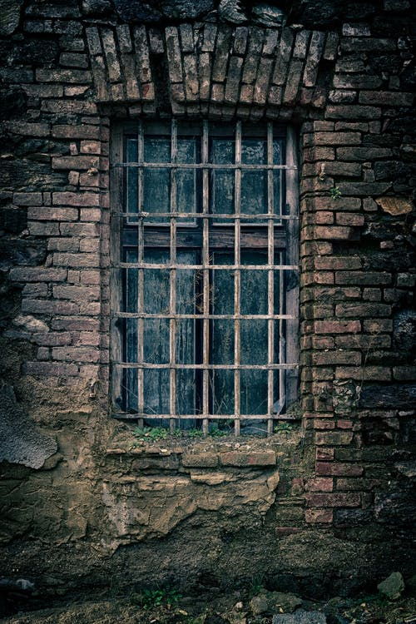
dear
From

Slide 4

Dear
From

Slide 5
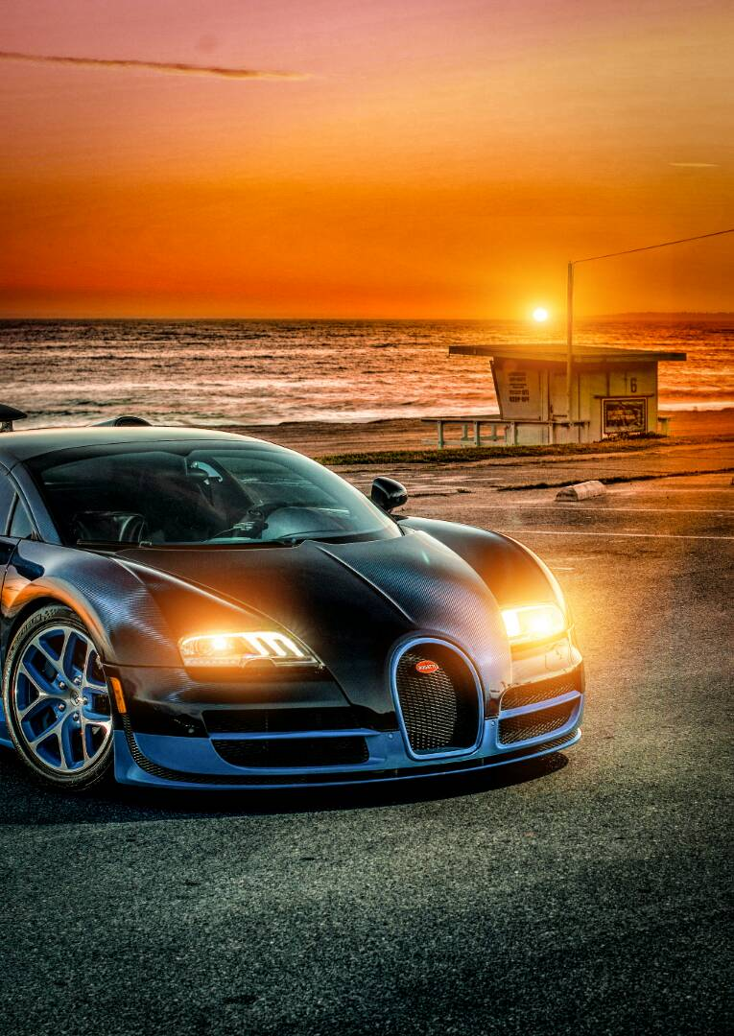

Dear
dear
From
From

Slide 6

Dear
From

Slide 7

Dear
From

Slide 8

Dear
From

Slide 9
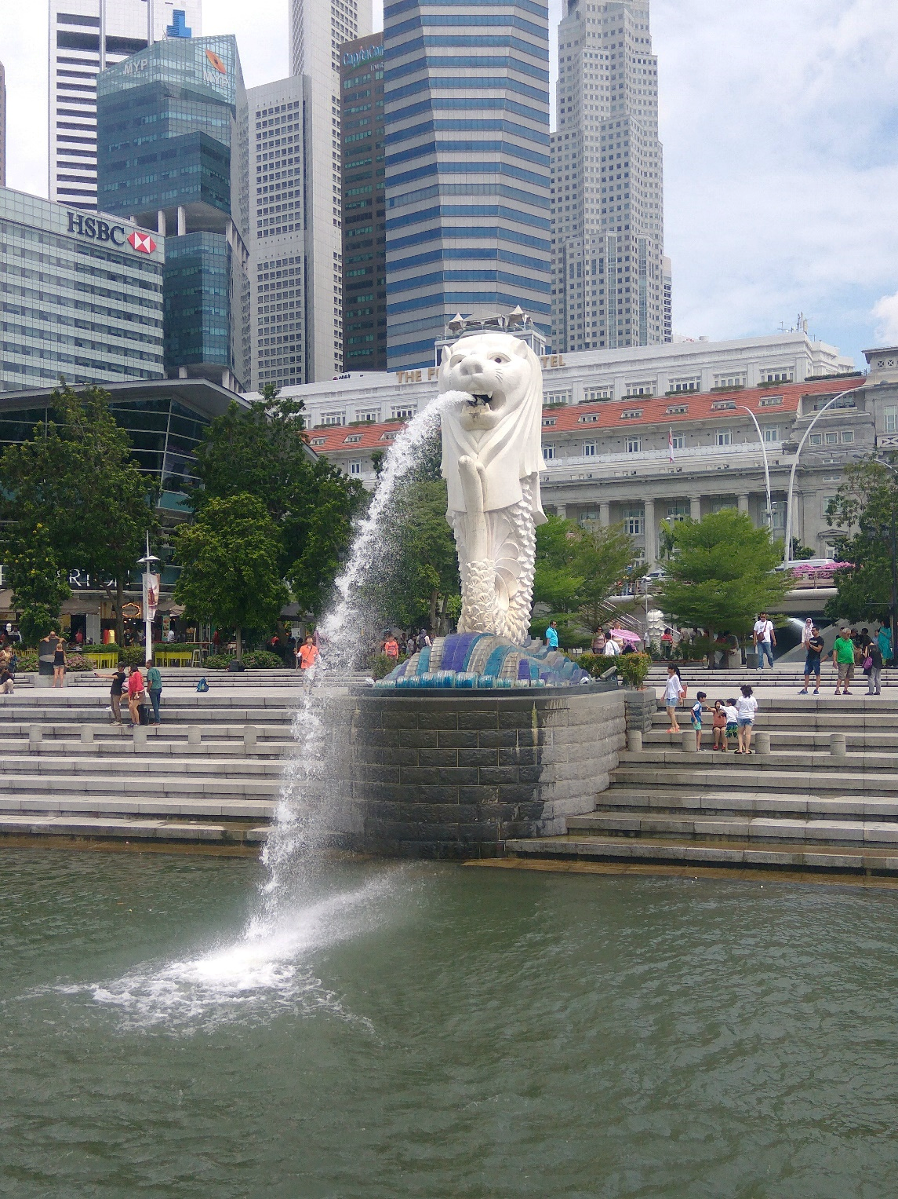

Dear
dear
From
From

Slide 10


Dear
Dear
From
From

Slide 11

Dear
From

Slide 12
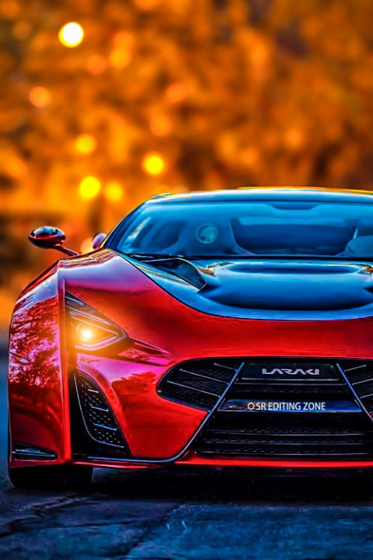
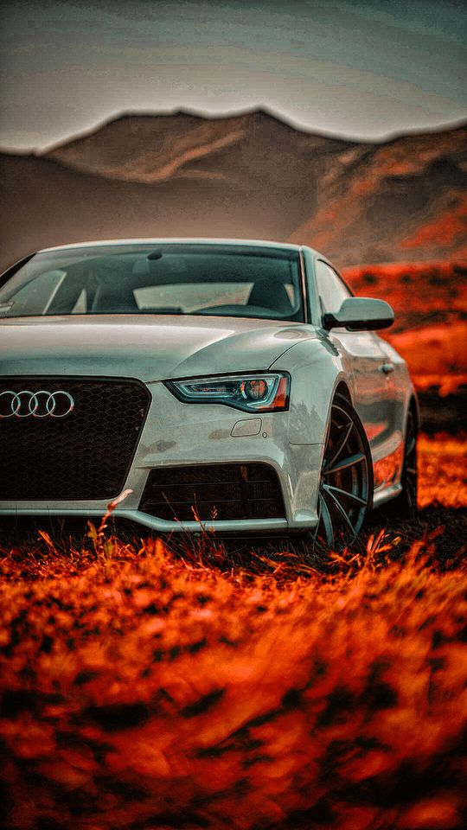
Dear
dear
From
From

Slide 13
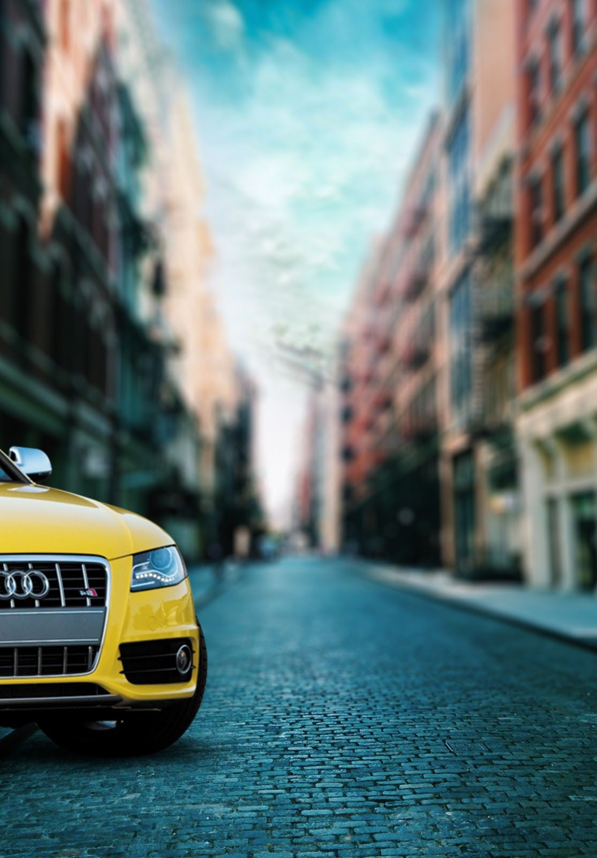
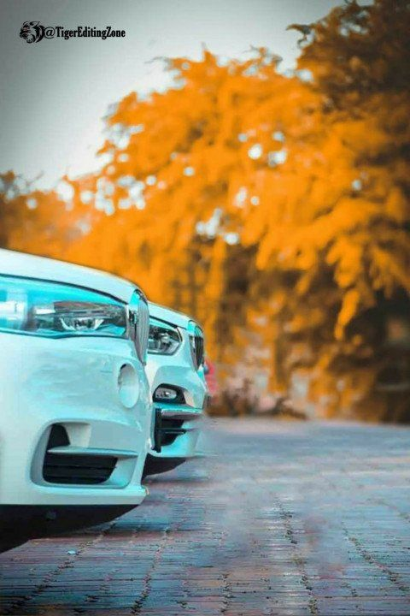
Dear
DEAR
From
From

Slide 14


DEAR
DEAR
From
FRom

Slide 15

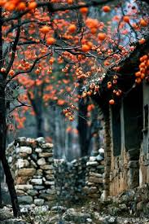
dear
dear
From
From

Slide 16


dear
DEAR
From
From

Slide 17

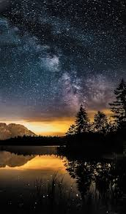
DEAR
DEAR
from
from

Slide 18


dear
DEAR
FRom
From

Slide 19

dear
From

Slide 20

dear
From

Slide 21

dear
From

Slide 22

dear
From

Slide 23

dear
From

Slide 24


Dear
DEAR
From
FROM

Slide 25


dear
dear
From
From

Slide 26

dear
FROM

Slide 27

Dear
From

Slide 28

DEAR
FROM

Slide 29

DEAR
From

Slide 30
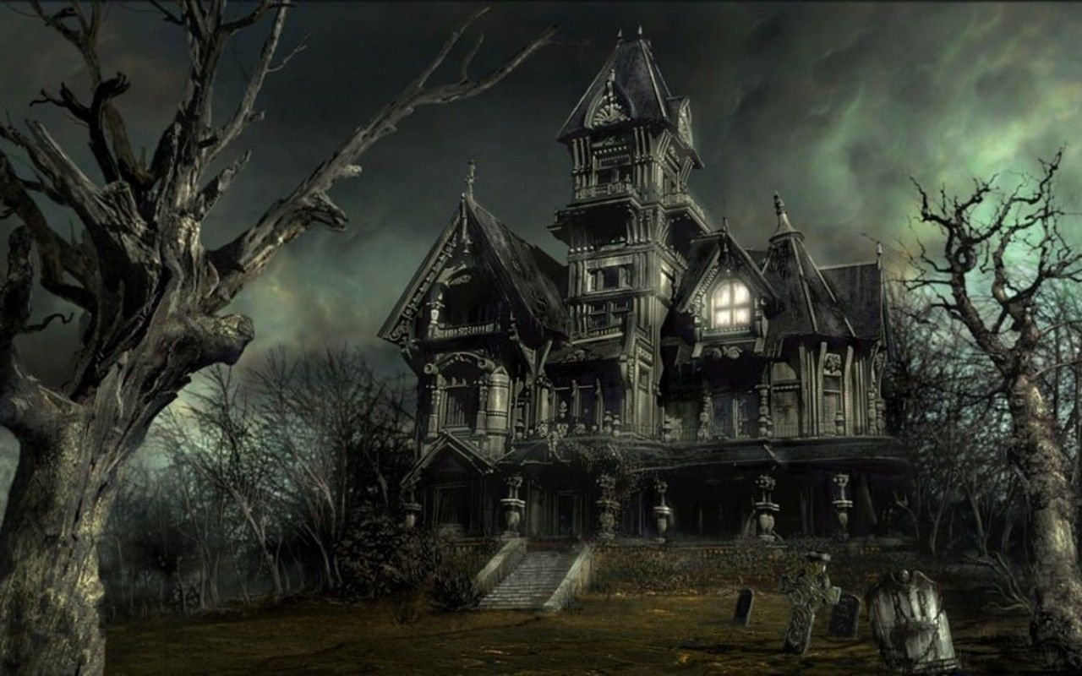
Dear
From

Slide 31

Dear
From

Slide 32

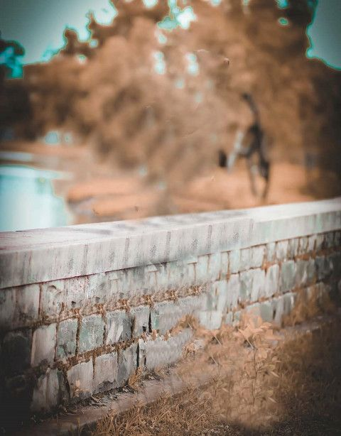
Dear
Dear
From
From

Slide 33


Dear
Dear
From
From

Slide 34
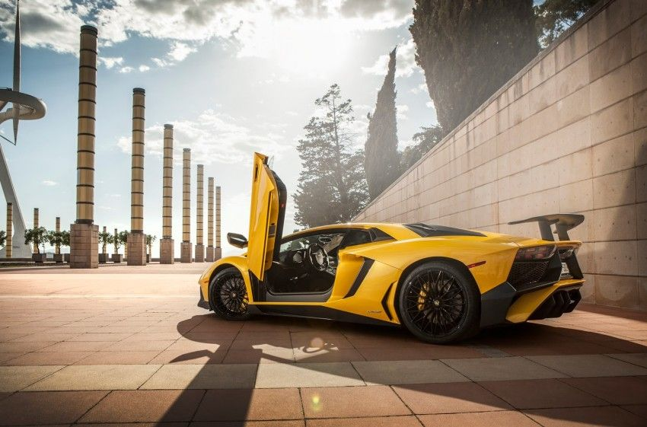
Dear
From

Slide 35



Dear
Dear
Dear
From
From
From

Slide 36

Dear
From

Slide 37

Dear
From

Slide 38

Dear
From

Slide 39

Dear
From

Slide 40

Dear
From

Slide 41

Dear
From

Slide 42

Dear
From

Slide 43

DEAR
FROM

Slide 44

DEAR
FROM

Slide 45

Dear
From

Slide 46

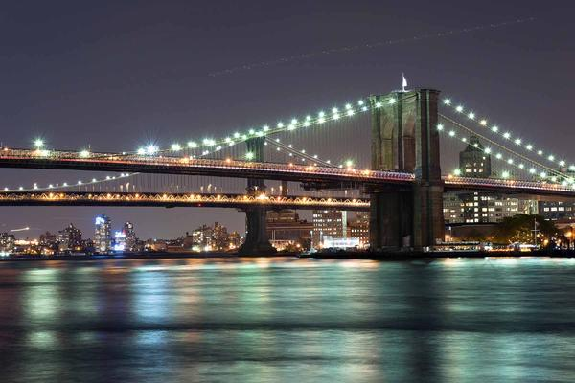
Dear
Dear
From
From

Slide 47

Dear
From

Slide 48
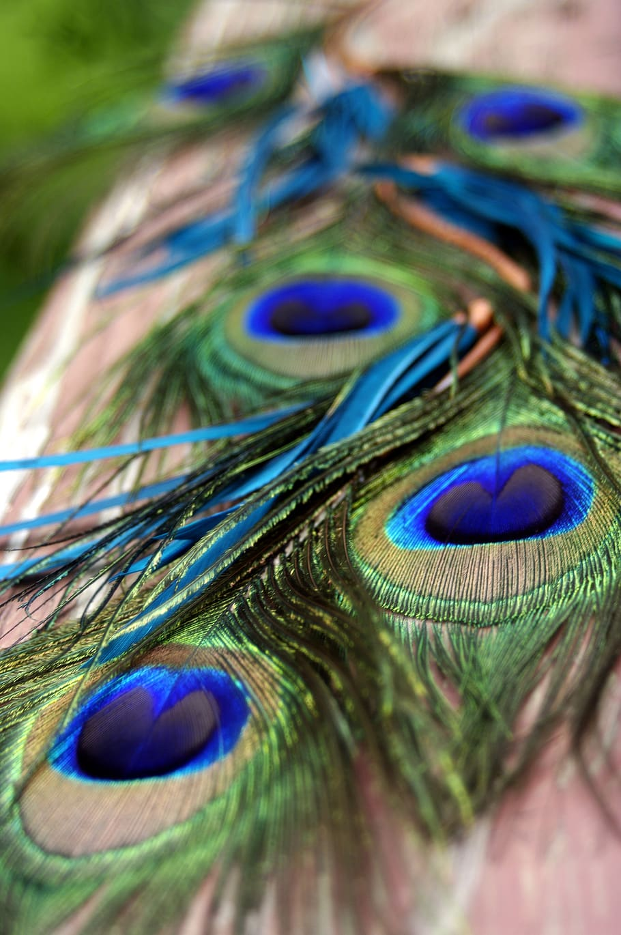
Dear
From

Slide 49

Dear
From

Slide 50

Dear
From

Slide 51

Dear
From

Slide 52

Dear
From

Slide 53

Dear
From

Slide 54

Dear
From

Slide 55

Dear
From

Slide 56

Dear
From

